Slide 1
Harris Corner detection

Slide 2
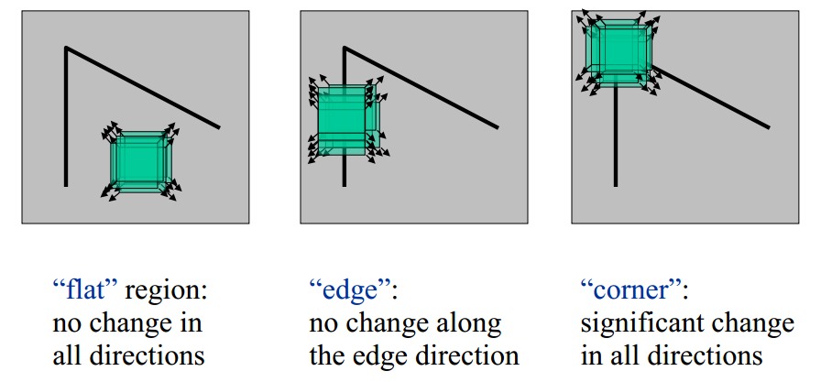
목적 / idea
https://dsp.stackexchange.com/questions/14338/corner-detection-using-chris-harris-mike-stephens
Note) gradient를 보고 있는 것
Corner를 찾고 싶음
Patch를 움직이면 Intensity 변화가 모든 방향으로 생길 때가 corner

Slide 3
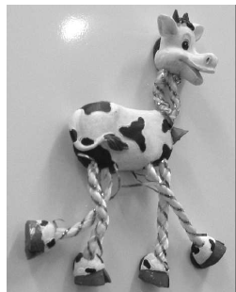
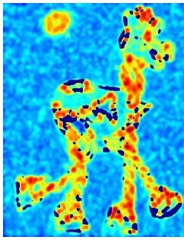
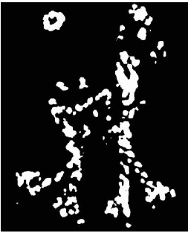
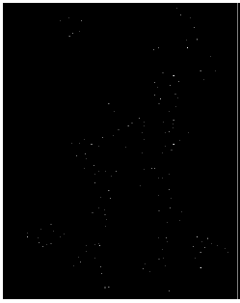
process
input
Calculate R
R> threshold
Local maximum (optional?)
Sobel X
Sobel Y
R계산(intensity 변화량을 수치화)

Slide 4

구현
E is the difference between the original and the moved window.
u is the window's displacement in the x direction
v is the window's displacement in the y direction
w(x, y) is the window at position (x, y). This acts like a mask. Ensuring that only the desired window is used.
I is the intensity of the image at a position (x, y)
I(x+u, y+v) is the intensity of the moved window
I(x, y) is the intensity of the original

Slide 5
수식 설명?
I(x,y), I(x+u, y)
I(x+u,y) – I(x, y)
W(x, y) * (I(x+u, y)-I(x,y))
I(x, y)를 전체 image로 생각해야.

Slide 6


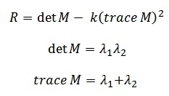



간략화?
Lambda : eigen values of M
Ix, Iy : sobel로 계산

Slide 7
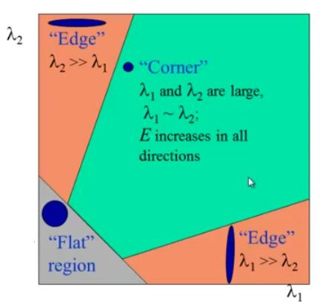

Slide 8
function
cv2.cornerHarris(src, blockSize, ksize, k[, dst[, borderType]]) → dst
src – Input single-channel 8-bit or floating-point image.
dst – Image to store the Harris detector responses.
blockSize – Neighborhood size (see the details on cornerEigenValsAndVecs() ).
ksize – Aperture parameter for the Sobel() operator. k – Harris detector free parameter. See the formula below. borderType – Pixel extrapolation method. See borderInterpolate() .

Slide 9
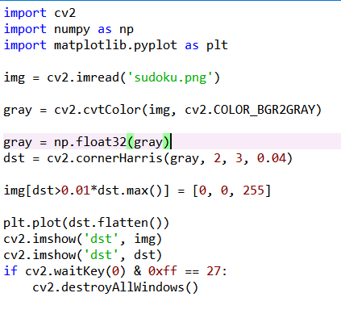
code

Slide 10
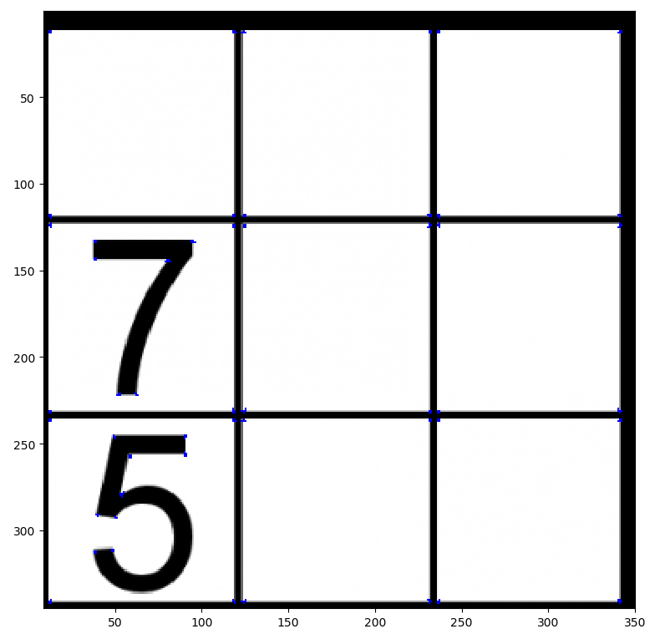
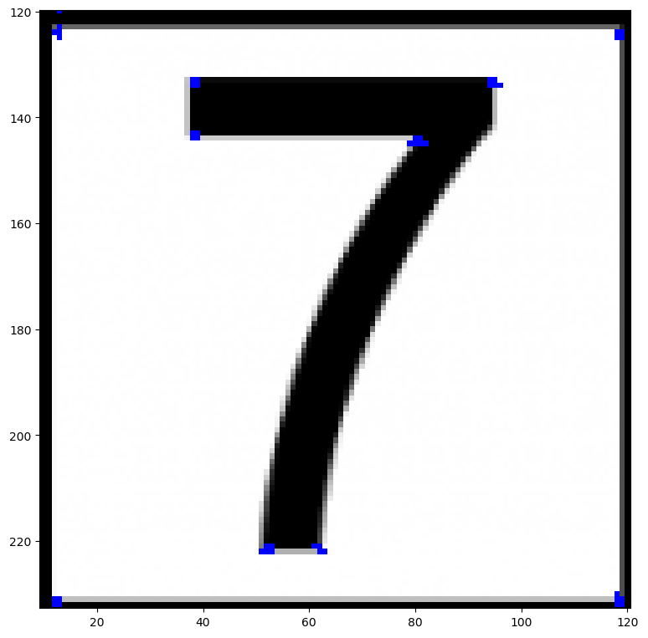
결과

Slide 11
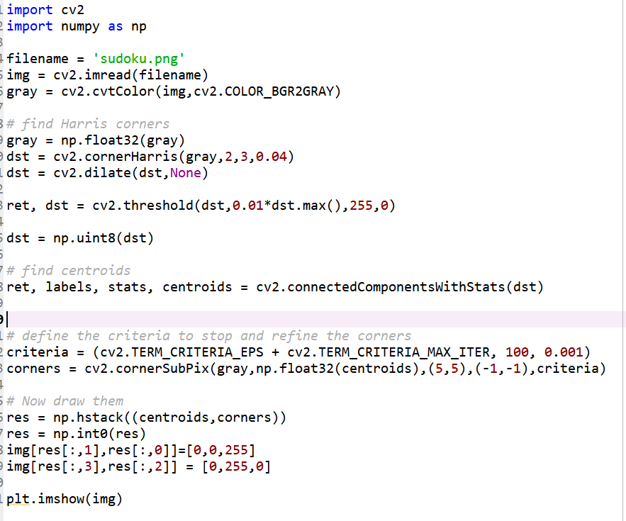

Slide 12
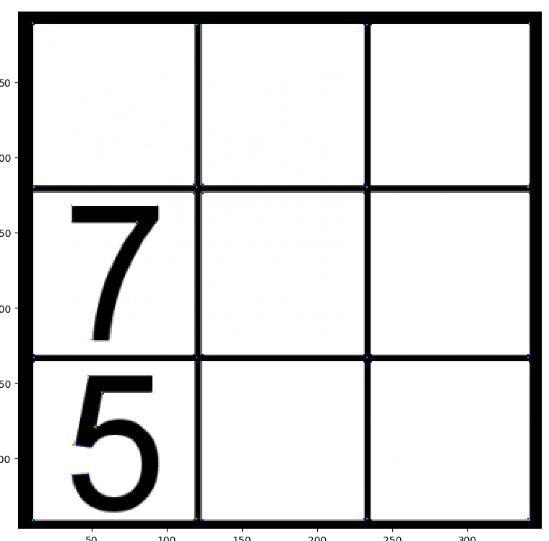
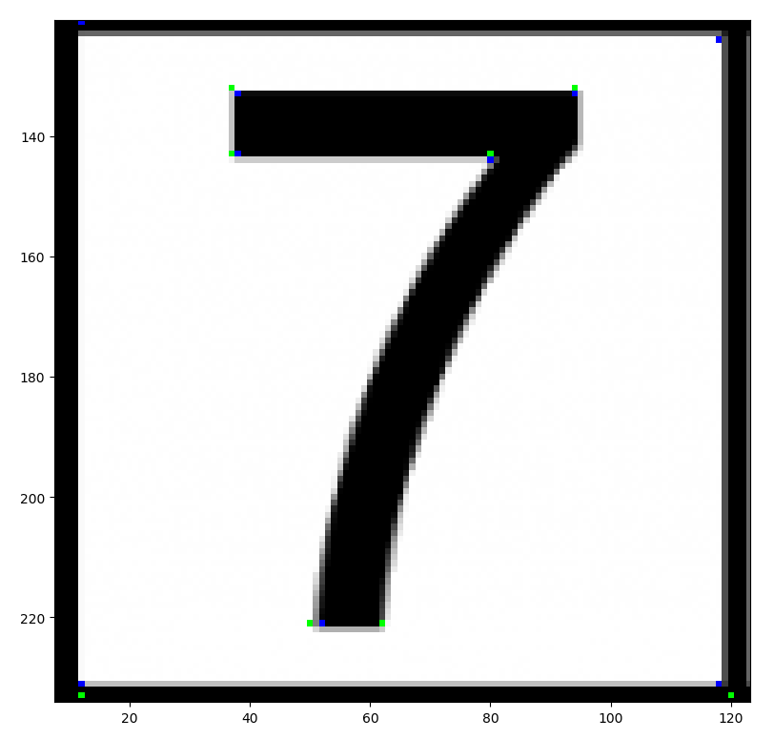
결과

